Slide 1
Boy Scout New Parent Orientation

Slide 2
Boys and Parents Today

Slide 3
What Does Scouting do for Families?

Slide 4
What Scouting is All About

Slide 5
Agenda

Slide 6
The Goals of Scouting

Slide 7
BSA Organizational Overview

Slide 8
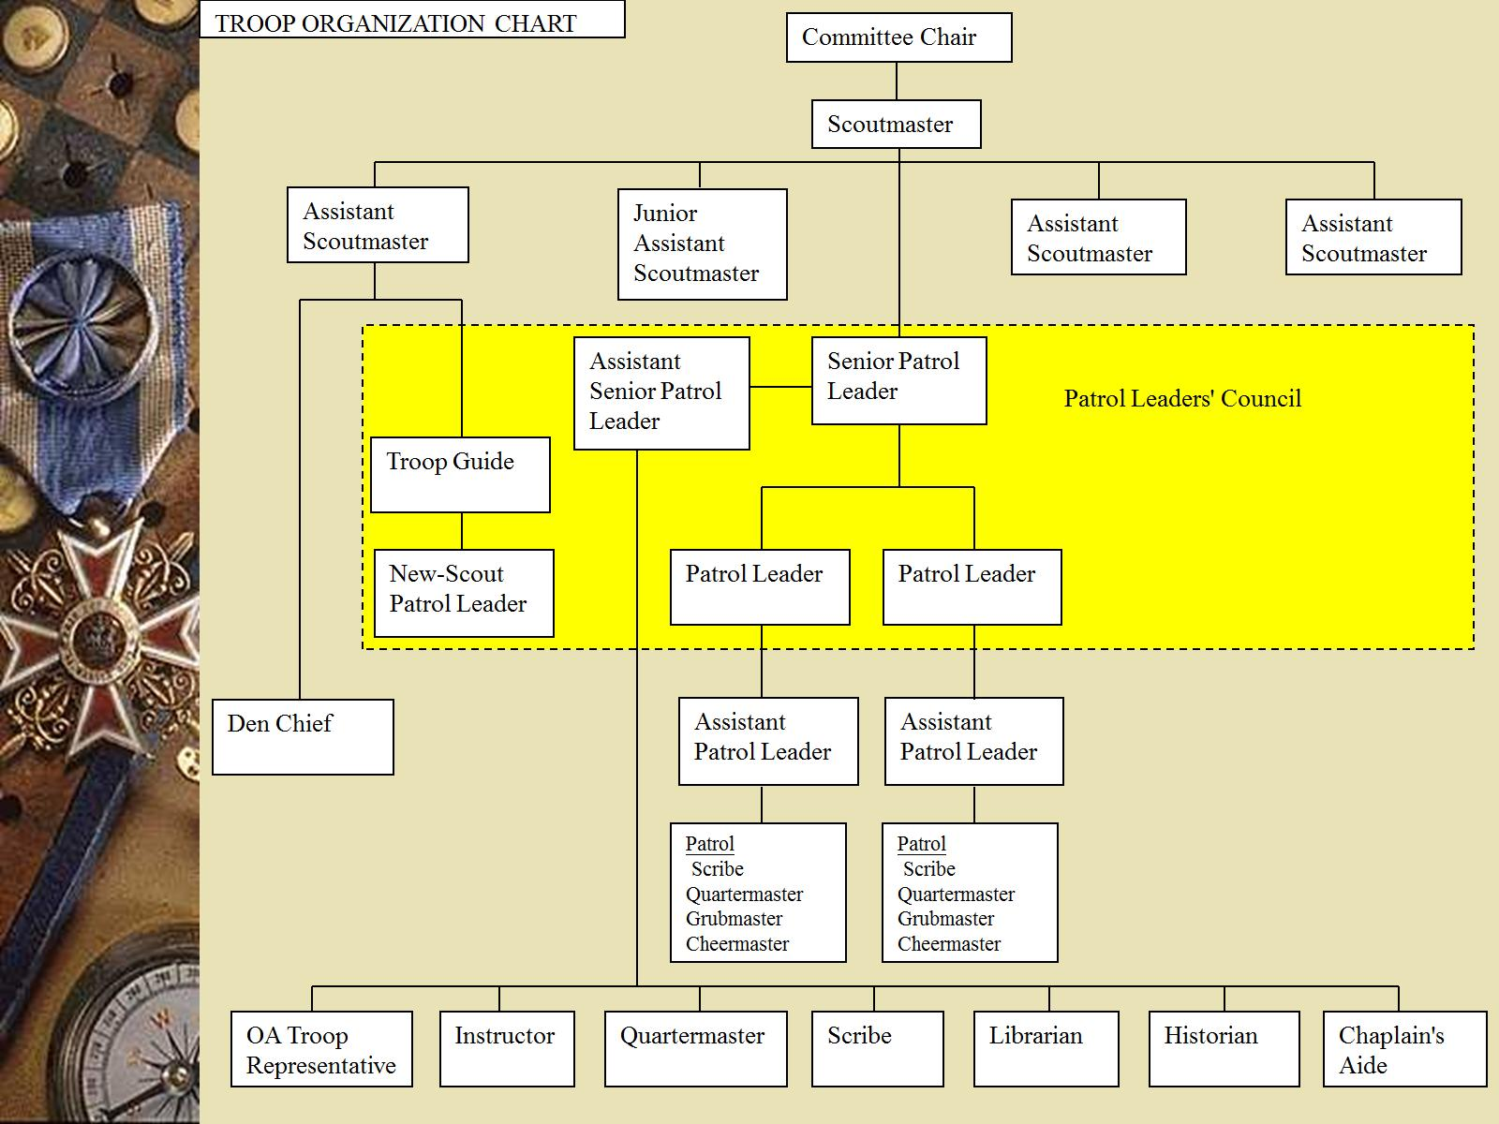

Slide 9
Program Area

Slide 10
Scout’s Leadership within Troop

Slide 11
Scout’s Leadership within Troop

Slide 12
Scout Leadership and Training

Slide 13
Boy Scout Advancements

Slide 14
Advancement Principles

Slide 15
Boy Scout Rank Advancement

Slide 16
Advancement - Merit Badges

Slide 17
Merit Badges

Slide 18
Scoutmaster Conferences(SMC)

Slide 19
Board of Review (BOR)

Slide 20
Recognition

Slide 21
Uniforms

Slide 22
Recommended Equipment

Slide 23
Other Important Stuff

Slide 24
Troop & Scout Communications

Slide 25
You need what?

Slide 26
How to Help

Slide 27
Parental Involvement

Slide 28
Service Projects

Slide 29
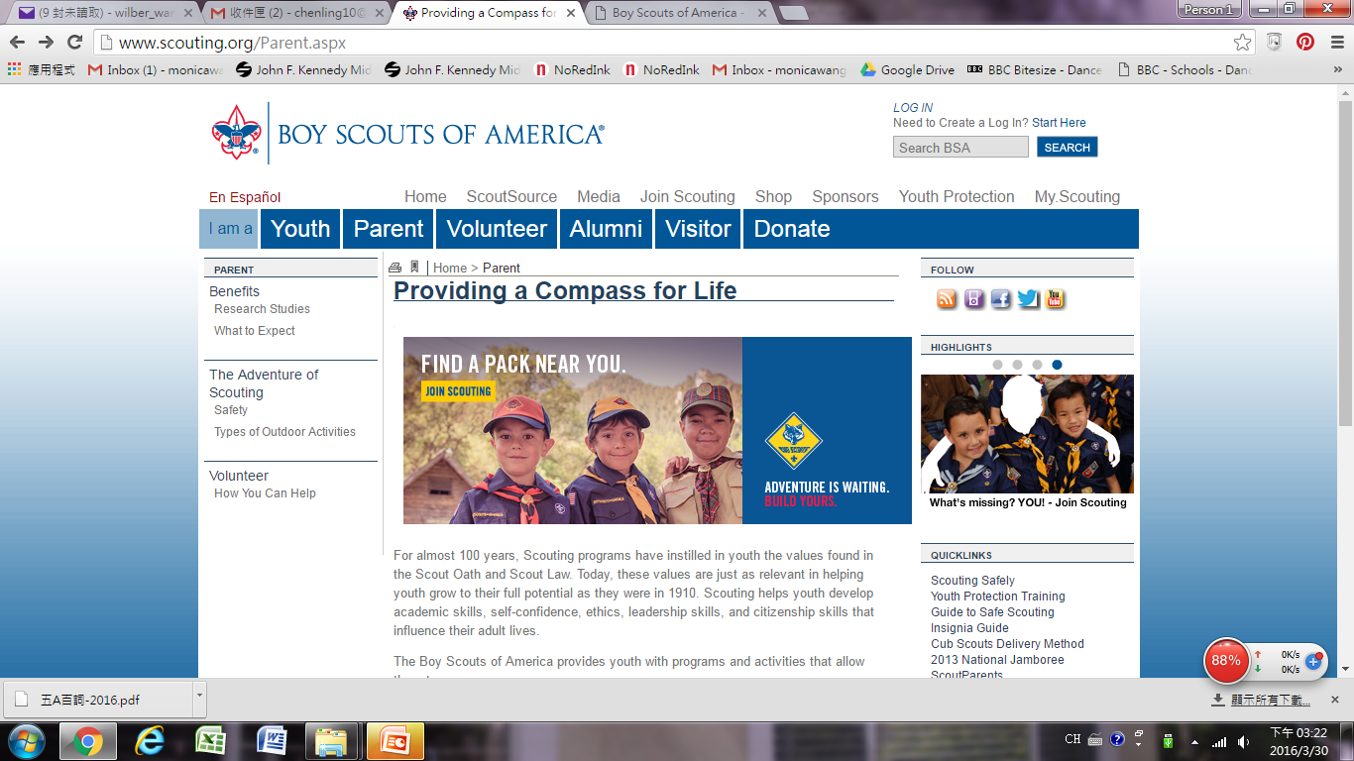
How to apply Youth Protection Certificate? As a parent of a boy scout, it’s useful to apply for Youth Protection Certificate. It lasts two years and it’s easy! Go to www.scouting.org

Slide 30
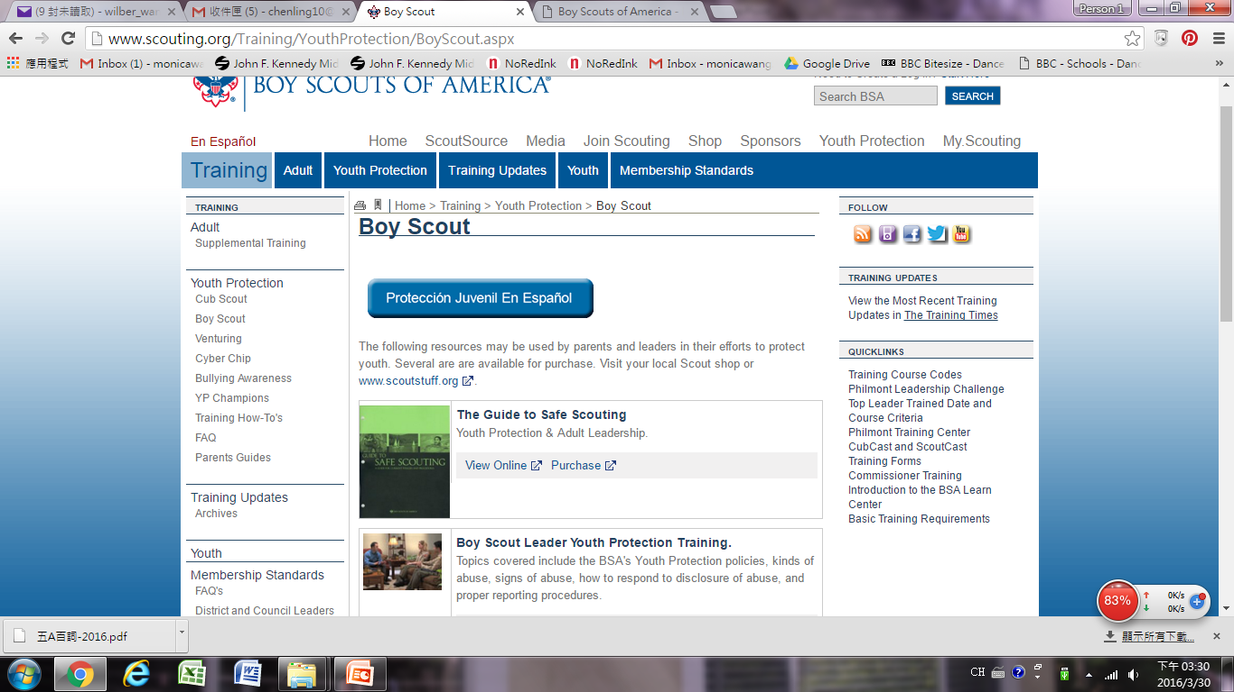
Click on “Youth Protection” on the right upper side.
Click into “Boy Scout”, and you’ll see the following page.
Click to “Take course online” in the second column. You need to register as a new user.
Print out the certificate at the end.

Slide 31
Q & A

